Slide 1
15 minutes or less!
Todd Schultz, Ph.D.
By Matthias Ripp CC-BY-SA

Slide 2
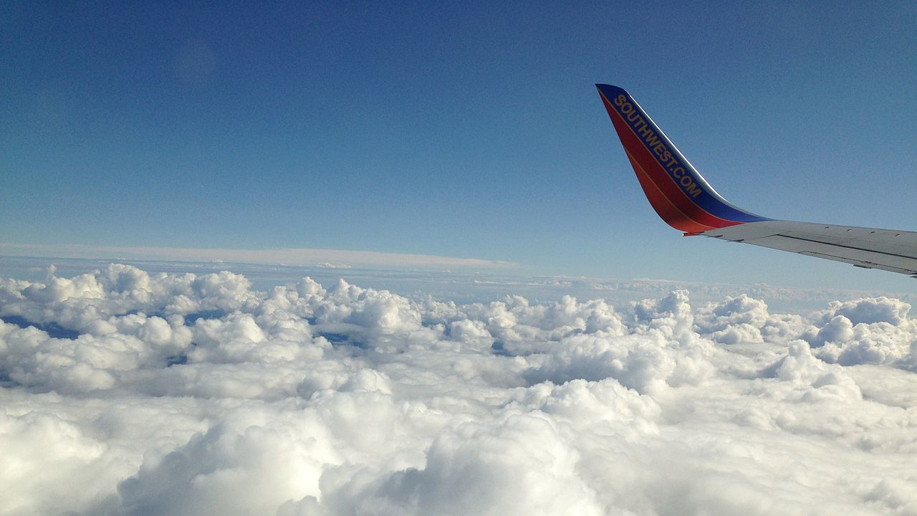
Have you ever traveled by airplane in the US?
By FASTILY CC BY-SA 3.0

Slide 3
Have you ever had a delayed arrival?
…that caused you to miss a flight?
By Belle-Noir Magazine CC BY-NC-ND 3.0

Slide 4
Purpose
To provide information to help air travelers avoid frustrating delays
By ccPixs.com CC-BY 2.0

Slide 5

How
To determine if a significant difference exists in the proportion of delayed arrival flights and the mean arrival delay for airports servicing the same metropolitan region
New York City
San Francisco Bay Area
Chicago
Public domain data from Kaggle Dataset entry Kaggle Flight Delays originally from the US Department of Transportation Bureau of Transportation Statistics
By Tero Vesalainen CC-0

Slide 6

How
To determine if a significant difference exists in the proportion of delayed arrival flights and the mean arrival delay for airports servicing the same metropolitan region
New York City
San Francisco Bay Area
Chicago
Public domain data from Kaggle Dataset entry Kaggle Flight Delays originally from the US Department of Transportation Bureau of Transportation Statistics
CC-0

Slide 7

The Big Apple
Airport | Proportion of arrival flights delayed | Mean arrival delay | Maximum arrival delay
JFK | 21% | 6.7 min | 1294 min
LGA | 25% | 10.4 min | 1196 min
EWR | 22% | 7.5 min | 1294 min
By Aurelien Guichard CC-BY-SA

Slide 8
The Bay Area
Airport | Proportion of arrival flights delayed | Mean arrival delay | Maximum arrival delay
SFO | 22% | 6.7 min | 1120 min
OAK | 18% | 4.7 min | 519 min
SJC | 17% | 4.2 min | 484 min
By Peter Craig CC-BY-SA

Slide 9
The Windy City
Airport | Proportion of arrival flights delayed | Mean arrival delay | Maximum arrival delay
ORD | 21% | 7.2 min | 604 min
MDW | 17% | 3.0 min | 1638 min
By J. Crocker CC-BY-SA

Slide 10
And the Winners are…
New York City: JKF
The Bay Area: SJC
Chicago: MDW
From publicdomainpictures.net CC0 Public Domain

Slide 11
Fine Print
Limitations
Only considered arrival airport
Data limited to 2015
Future work
Expanding to more cities
Increasing the data factors included in the analysis

